Slide 1

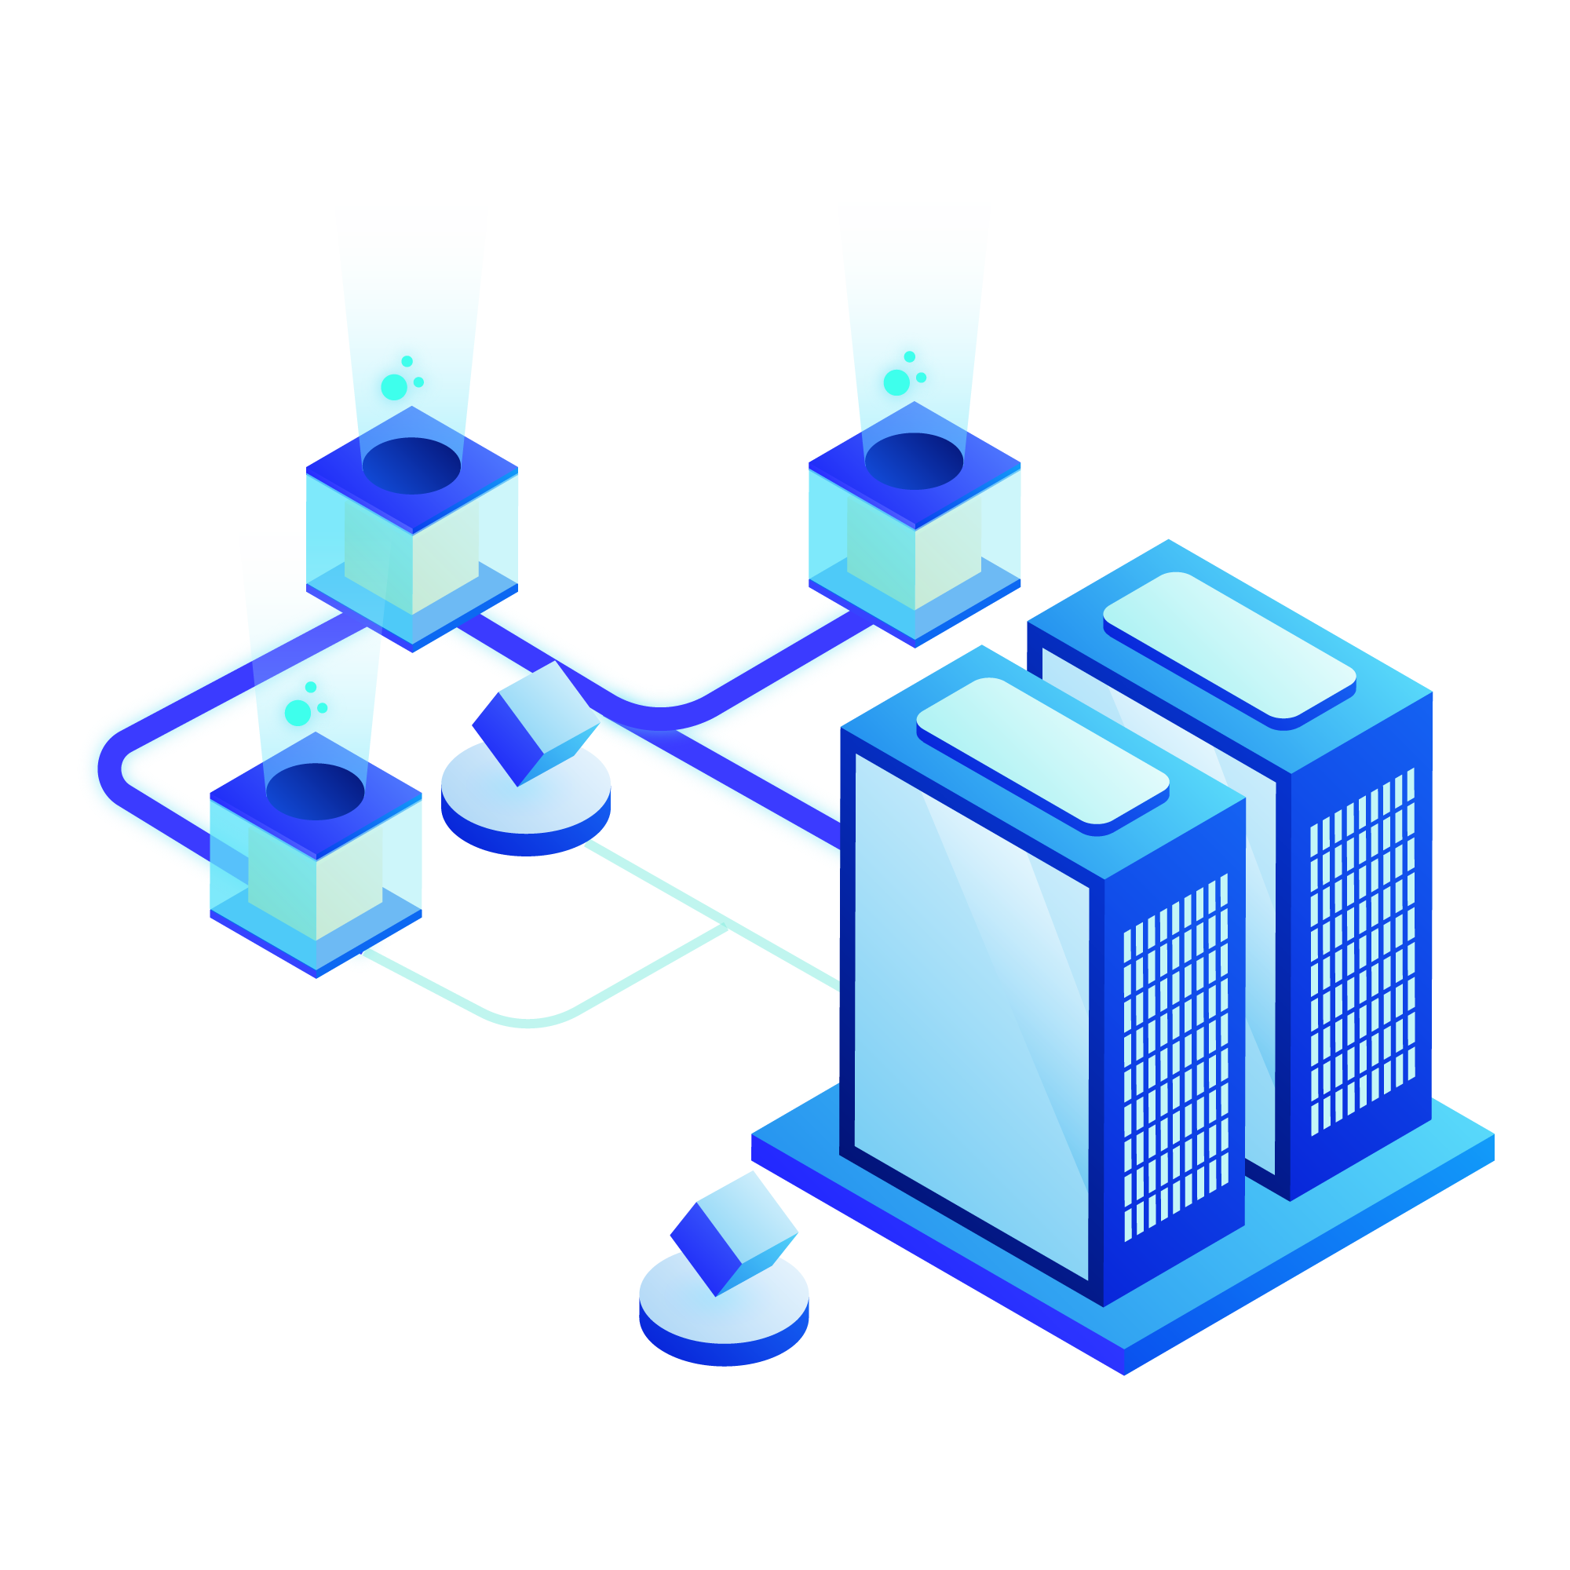
International Winter School on Blockchain Technology and Applications – Hyperledger
2024
Patient Consent Management
Tannishtha Devgun
Fatemeh Esmaeilnezhadtanha
Marco Gerardi
Samia Guesmi

Slide 2
Project Description:
Healthcare Informed Consent
Electronic Consent (e-consent)
Definition: Medical professionals informing patients about risks, benefits, and alternatives of a procedure.
Importance: Patient's capacity for independent and voluntary decision-making is crucial.
Definition: Digital methods for patient consent, with electronic signatures and revocation flexibility.
Current Situation: Majority of e-consent models use centralized architecture.
Trusted Third-Party: Some incorporate
third-party delegation for consent
1
Decentralized Models with Blockchain
2
Emerging Trends: Decentralized e-consent models utilizing blockchain technology are gaining prominence.
Proposal: Introduce an e-consent system with a fully decentralized architecture.
Technology Basis: Hyperledger Fabric serves as the foundation for the proposed decentralized system
3

Slide 3
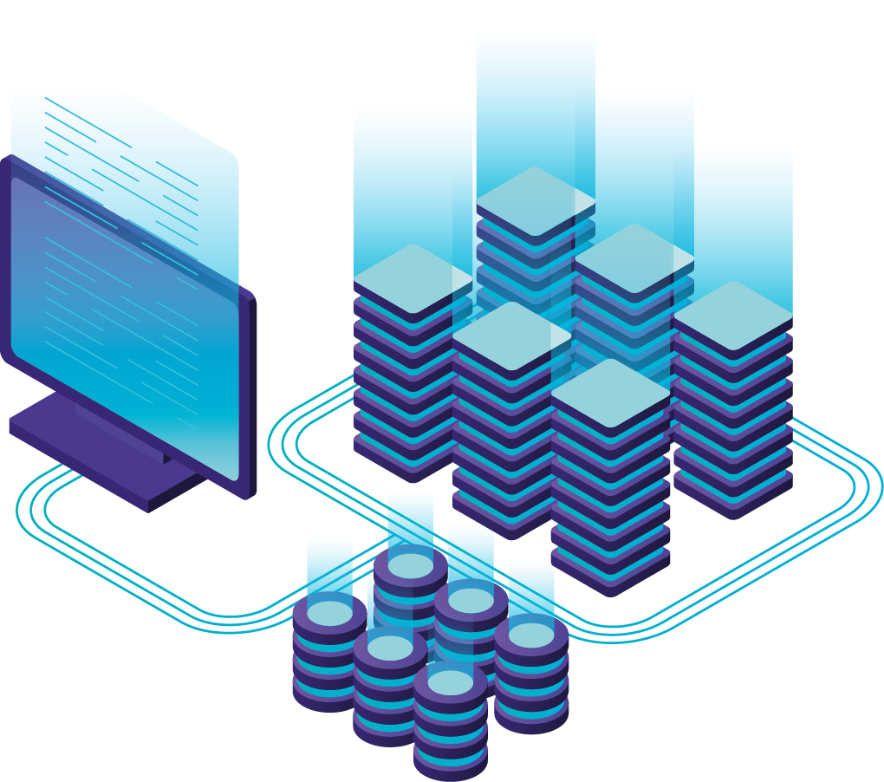
List of Functions
initLedger(ctx)
registerPatient(ctx, patientId, name, age,data)
It is used to initially fill the ledger
Add new Patient
getAllPatients(ctx)
getPatientData(ctx, patientId)
Returns data of all patients found in the world state
get the data of the patient with patientId
getPatientsWithConsent(ctx)
revokeConsent(ctx, patientId)
Returns the list of patients who have given their consent to share their data
Remove concent of the patient with the patientId “only the owner can invoque this function”
getConsentedPatientsBetweenAges(ctx, minAge, maxAge)
giveConsent(ctx, patientId)
Returns the list of patient who are give their consent and their age is between minAge and maxAge
update the consent field to true and “only the owner can invoke this function”

Slide 4
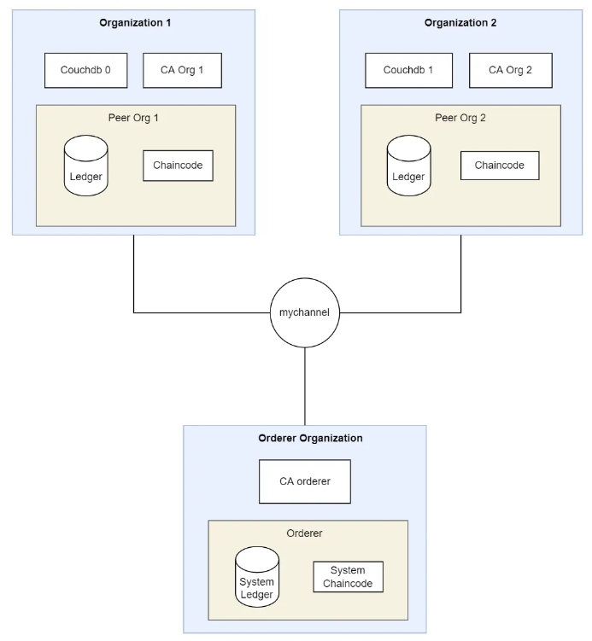

Network Diagram
User select the chaincode from the application UI
and submit it to the backend
Application UI
Backend
Backend calls fabric commands to deploy, invoque, query chaincode
Hyperledger Fabric Network

Slide 5
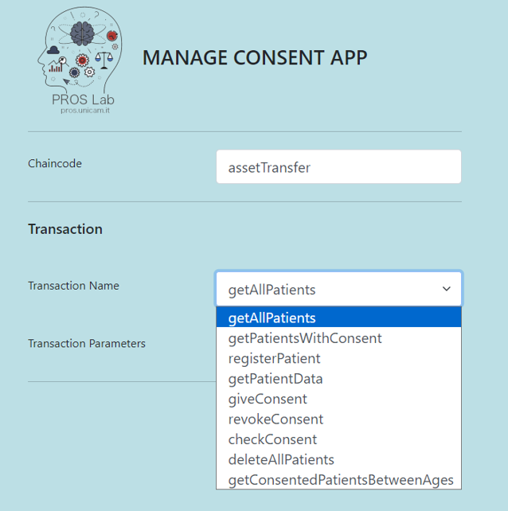
Use case
01
List of available functions in the smart contract

Slide 6
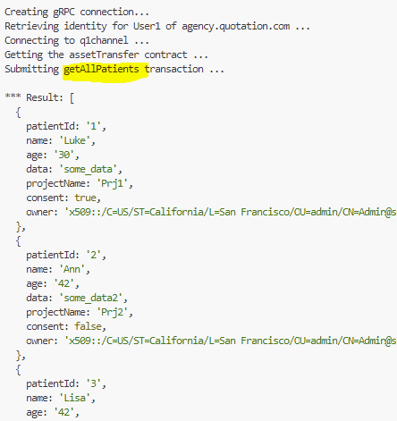
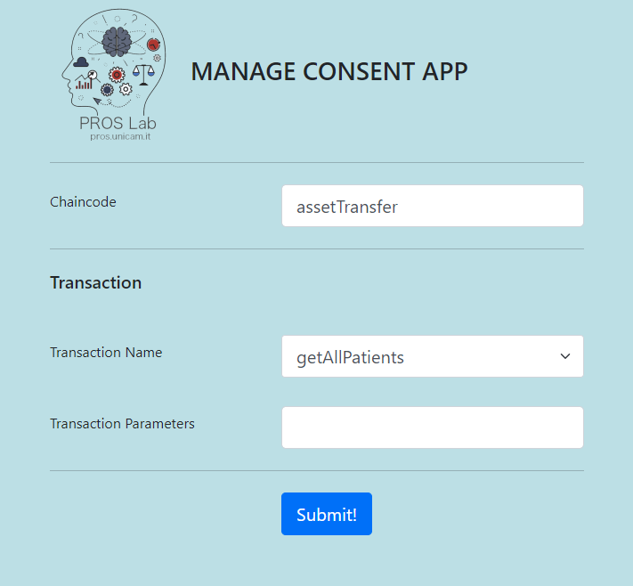
Use case
02
getAllPatients Function call

Slide 7
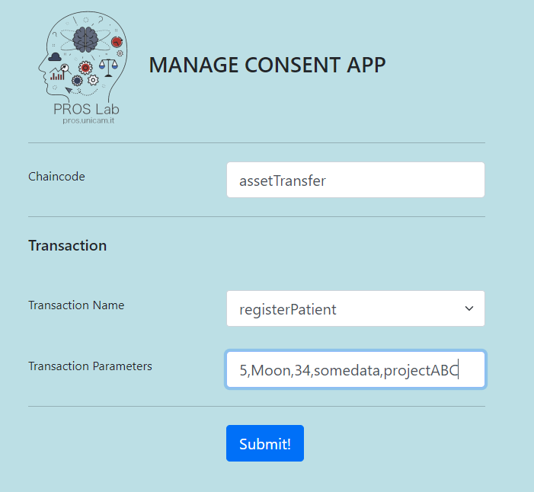
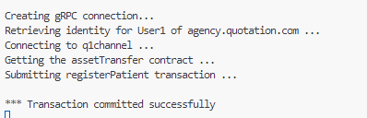
Use case
03
Patient Registration

Slide 8
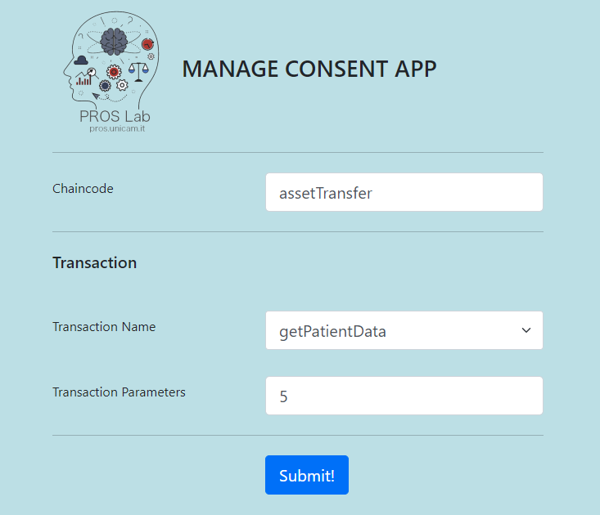
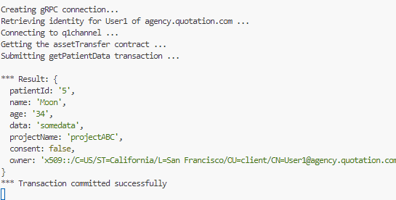
Use case
04
Check Patient Registration

Slide 9
THANKS FOR YOUR ATTENTION!

Slide 10
Use case

